Slide 1
Square and cube roots
Properties of number: factors, multiples, squares and cubes

Slide 2
how to use Oak lessons

Slide 3
I can explain the concept of square root and cube root and calculate them.

Slide 4

A perfect square is a number that is the second exponent of an integer. It is usually shortened to square number.
1 ✕ 1 =
1
Square numbers
Perfect squares
2 ✕ 2 =
4
1
, 4
, 9
, 16
, 25
, 36
, 49
, 64
, 81
, 100,
121…
3 ✕ 3 =
9
A perfect cube is a number that is the third exponent of an integer. It is usually shortened to cube number.
4 ✕ 4 =
16
1 ✕ 1 ✕ 1 =
1
Cube numbers
Perfect cubes
2 ✕ 2 ✕ 2 =
8
1
, 8
, 27
, 64
, 125 …

Slide 5

Square and cube roots
Square root
Cube root

Slide 6
Square root
Here is a table to help us see how perfect square numbers are formed
Integer | Array | Calculation | Perfect square number
1
2
3
4
1 ✕ 1
1
2 ✕ 2
4
3 ✕ 3
9
4 ✕ 4
16

Slide 7
Square root
Let’s remove the array. Can you work out the missing information?
Integer | Calculation | Perfect square number
5
6
5 ✕ 5
25
6 ✕ 6
36
8
8 ✕ 8
64
10
10 ✕ 10
100
12
12 ✕ 12
144

Slide 8
Square root
Integer | Calculation | Perfect square number
5
6
5 ✕ 5
25
6 ✕ 6
36
The square root of the perfect square is the integer that has been multiplied by itself to give that perfect square number.
Square root of 25 is 5
Square root of 36 is 6

Slide 9



Square root
Integer | Calculation | Perfect square number
5
6
5 ✕ 5
25
6 ✕ 6
36
We use to represent the square root.
= 5
Square root of 25 is 5
= 6
Square root of 36 is 6

Slide 10


Square root
169 is a perfect square. What is ? Justify your answer.
This is because 13 ✕ 13 = 169
84.5
12
13
14

Slide 11
Square root
Which of the following is the square root of the perfect square 121? Justify your answer.
This is because 11 ✕ 11 = 121
60.5
12
11
40.3

Slide 12
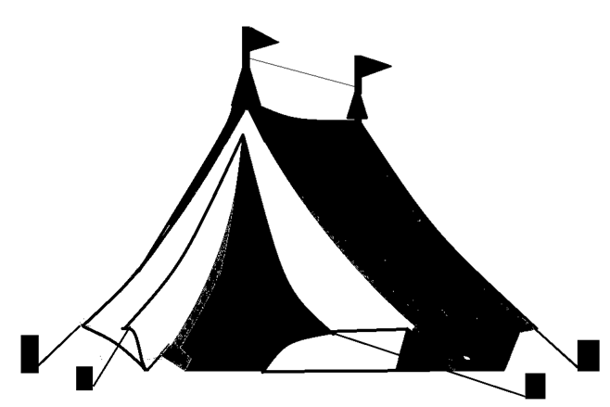


Square root
20 is not a perfect square so we do not get an integer when we . The closest perfect square to 20 is 16 The biggest tent we can get is Tent C, 4 m by 4 m tent because
A shop only sells square base tents with integer lengths.
A family campsite has a campsite area for each family of a maximum of 20 m². What is the biggest tent a family can pitch at the campsite?
Tent A: 2 m by 2 m
Tent B: 3 m by 3 m
Tent C: 4 m by 4 m
Tent D: 5 m by 5 m

Slide 13




Square root
1) Match the square root of the perfect square with the correct answer.
6
2
9
7
15

Slide 14



Square root
2) Work out the missing numbers using your knowledge of perfect squares and square roots.
b)
c)

Slide 15
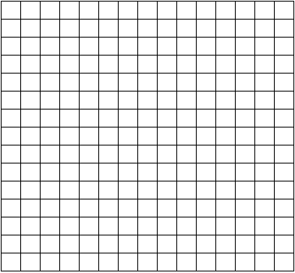
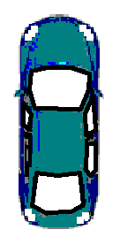
Square root
3) An outdoor party has plot allocation of 100 m² for all the guests. The party will have a kitchen/dining area, cake table, square bouncy castle and a car to power the bouncy castle.
Insert all items onto the plot. What is the largest bouncy castle you can put on your plot so there is at least one square gap between each item.
Each square is 1 m² .
Bouncy castle
kitchen/diner
Car
Cake table
?
2 m
3 m
2 m
?
2 m
6 m
5 m

Slide 16




Square root
4) Only inserting perfect square numbers, fill in the missing gaps.
is closest to
b) is closest to
c) is closest to

Slide 17
Square root
Match the square root of the perfect square with the correct answer.
6
2
9
7
15

Slide 18
Square root
2) Work out the missing numbers using your knowledge of perfect squares and square roots.
b)
c)
100
4
1
81
16
36

Slide 19
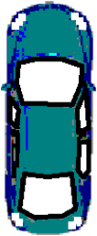
Square root
3) There are lots of different ways you can position your items.
Calculating the largest bouncy castle can be done by:
100 - 4 - 18 - 10 = 68
Closest perfect square to 68 is 64. The largest is an 8 m by 8 m bouncy castle.
kitchen/diner
Cake table
Car
This is not practical.
2 m
3 m
2 m
2 m
6 m
5 m

Slide 20
Square root
3) There are lots of different ways you can position your items.
The most practical with at least one square gap between items is the 6m by 6m bouncy castle.
kitchen/diner
Cake table
Car
2 m
3 m
2 m
2 m
6 m
5 m

Slide 21
Square root
4) Only inserting perfect square numbers, fill in the missing gaps.
is closest to
b) is closest to
c) is closest to
64
81
144

Slide 22
Square and cube roots
Square root
Cube root

Slide 23
Cube root
A cube number is the product of three repeated integers.
A perfect cube is the same as a cube number.
1 ✕ 1 ✕ 1 =
1
Perfect cubes
2 ✕ 2 ✕ 2 =
8
1
, 8
, 27
, 64 …

Slide 24
Cube root
Putting this in a table, can you work out the missing information?
Integer | Calculation | Perfect cube number
1 | 1 ✕ 1 ✕ 1 | 1
2 | 2 ✕ 2 ✕ 2 | 8
3
4
3 ✕ 3 ✕ 3
27
4 ✕ 4 ✕ 4
64
5
5 ✕ 5 ✕ 5
125
10
10 ✕ 10 ✕ 10
1000

Slide 25
Cube root
Integer | Calculation | Perfect cube number
5
10
5 ✕ 5 ✕ 5
125
10 ✕ 10 ✕ 10
1000
The cube root of the perfect cube is the integer that has been multiplied by itself and then itself again to give that perfect cube number.
Cube root of 125 is 5
Cube root of 1000 is 10

Slide 26



Cube root
Integer | Calculation | Perfect cube number
5
10
5 ✕ 5 ✕ 5
125
10 ✕ 10 ✕ 10
1000
We use to represent the cube root.
= 5
Cube root of 125 is 5
= 10
Cube root of 1000 is 10

Slide 27



Cube root
Match the cube root of the perfect cube with the correct answer.
6
2
10
5
1

Slide 28

Cube root
What is the closest integer to ?
Alex says “It is 10”
Sofia says “It is 5”
Andeep says “It is 4”
Who is correct? Explain your answer.
10 ✕ 10 ✕ 10 = 1000
5 ✕ 5 ✕ 5 = 125
4 ✕ 4 ✕ 4 = 64
64 is closer to 90 than 125 or 1000. Therefore Andeep is closest.

Slide 29




Cube root
Which of the following will give an integer answer?

Slide 30

Cube root
2) What is the closest integer to ?
Laura says “It is 6”
Jun says “It is 5”
Who is correct? Explain your answer.

Slide 31




Cube root
3) Work out the answers to the following using your knowledge of square and cube roots of perfect square and perfect cube numbers.
b)
c)
d)

Slide 32
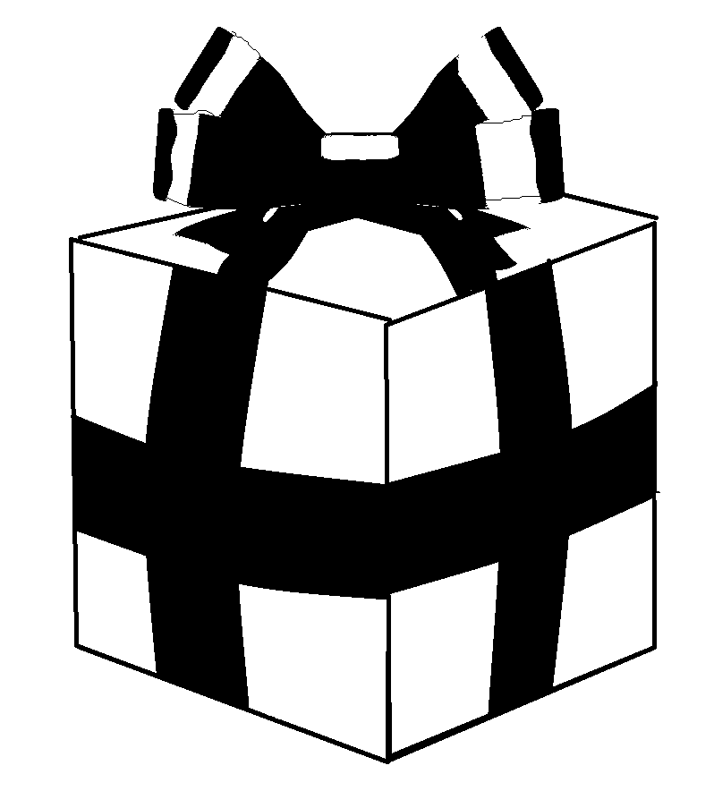
Cube root
4) Izzy has puzzle cube gift for Lucas. The puzzle cube has a length of 4.5 cm. She needs to select the correct gift box. The gift boxes are also cubes. Which is the best choice for the puzzle cube?
Explain your answer.
Volume = 1000 cm³
Volume = 512 cm³
Volume = 64 cm³

Slide 33
Cube root
Which of the following will give an integer answer?

Slide 34
Cube root
2) What is the closest integer to ?
Laura says “It is 6”
Jun says “It is 5”
Who is correct? Explain your answer.
6 ✕ 6 ✕ 6 = 216
5 ✕ 5 ✕ 5 = 125
216 is closer to 200 than 125. Therefore Laura is correct.

Slide 35
Cube root
3) Work out the answers to the following using your knowledge of square and cube roots of perfect square and perfect cube numbers.
b)
c)
d)
= 5 - 1
= 4
= 10 + 8
= 18
= 10 + 2
= 12
= 4 - 8
= -4

Slide 36
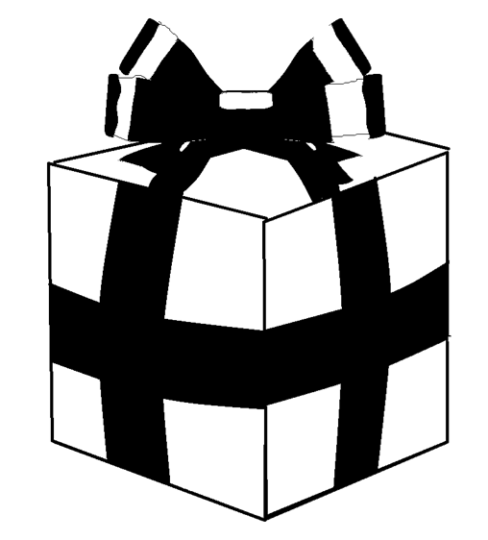
Cube root
4) Izzy has puzzle cube gift for Lucas. The puzzle cube has a length of 4.5 cm. She needs to select the correct gift box. The gift boxes are also cubes. Which gift box is the best choice for the puzzle cube?
Explain your answer.
Volume = 1000 cm³
Volume = 512 cm³
Volume = 64 cm³
Length of gift box is 10 cm
Length of gift box is 8 cm
Length of gift box is 4 cm

Slide 37

Square and cube roots
The of the perfect square is the integer that has been multiplied by itself to give that perfect square number.
The of the perfect cube is the integer that has been multiplied by itself and then itself again to give that perfect cube number.

Slide 38

© Oak National Academy 2023.
Produced in partnership with Mathematics in Education and Industry.
Licensed on the Open Government Licence v3.0, except where otherwise stated. See Oak terms and conditions.

